Slide 1

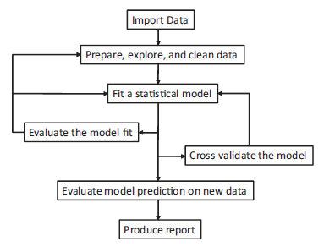
Road Map

Slide 2
Prepare and Clean Data
Loop n times
data (data frame)
IDlist (vector)
oneUserData (data frame)
Read raw usage data
Sort by ID
Sort by TIME
Generate list of unique ID
Time series subset of ID
Generate characteristics of single user
1-row of data per ID
Std. 90-day time series
Time Series Results
R Libraries
user (data frame)
Use
sessionFrame (data frame)
Static Characteristics

Slide 3
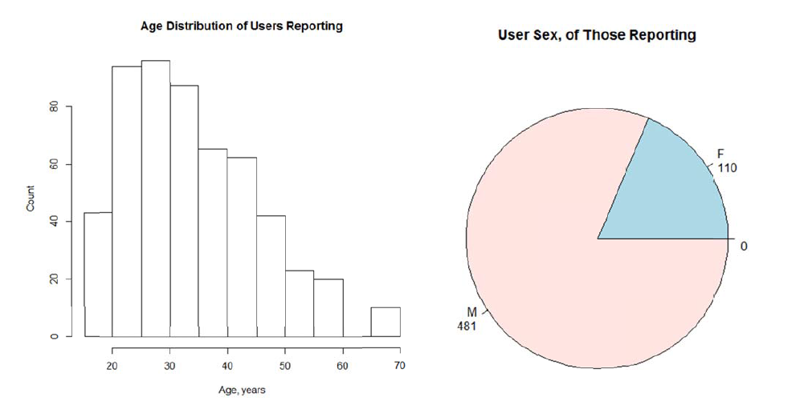
Demographics (4.5% response)
Age Distribution
Gender Distribution
Mean = 34.5

Slide 4
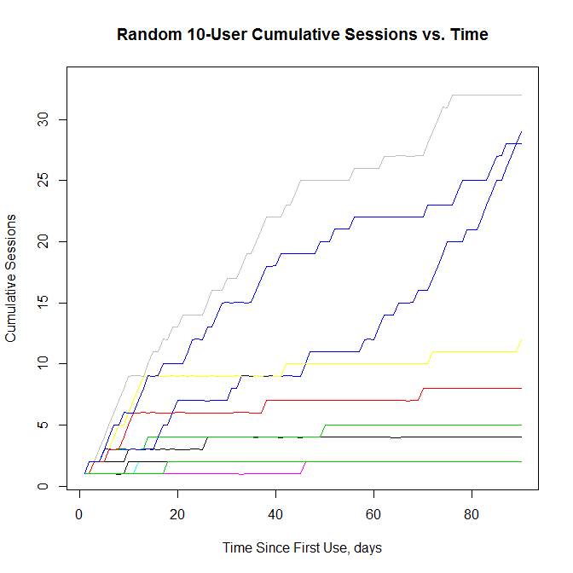
Explore Data
Cumulative Sessions vs. Time, 10 Random Users

Slide 5
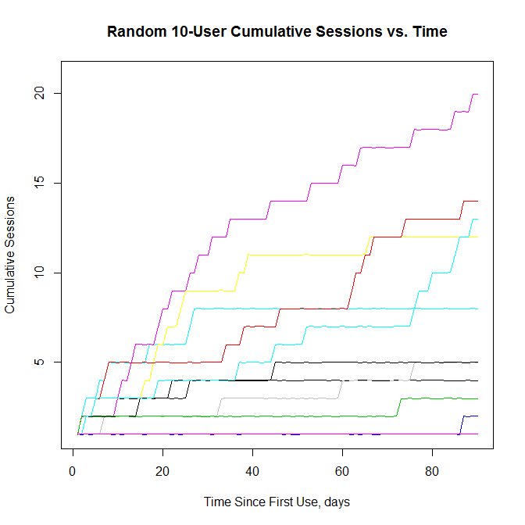
Explore Data
Cumulative Sessions vs. Time, 10 Random Users

Slide 6
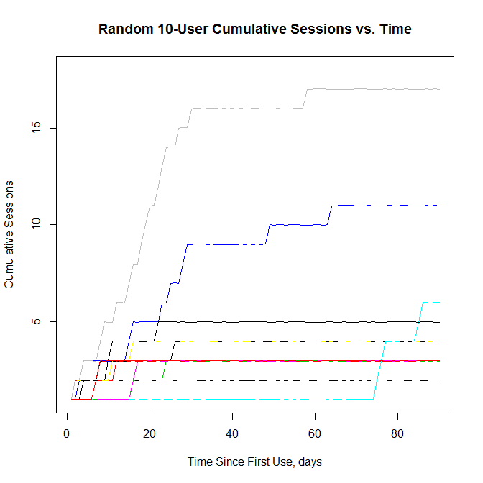
Explore Data
Cumulative Sessions vs. Time, 10 Random Users

Slide 7
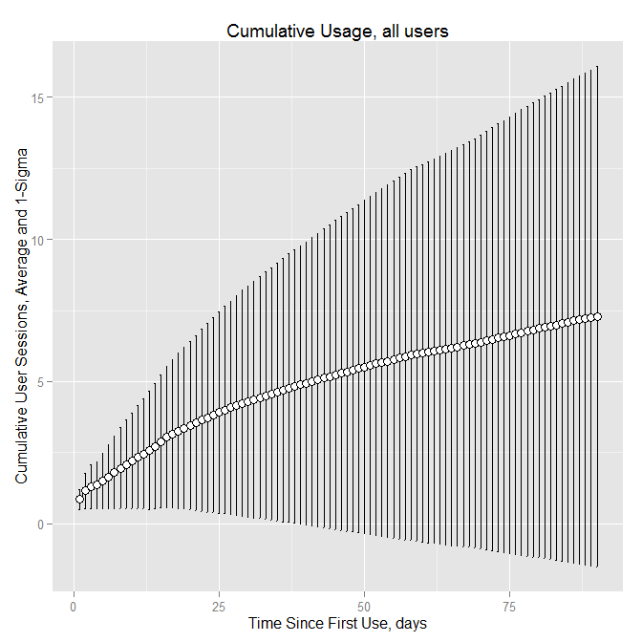
Explore Data
Mean ± 1σ Cumulative Sessions vs. Time, All Users

Slide 8
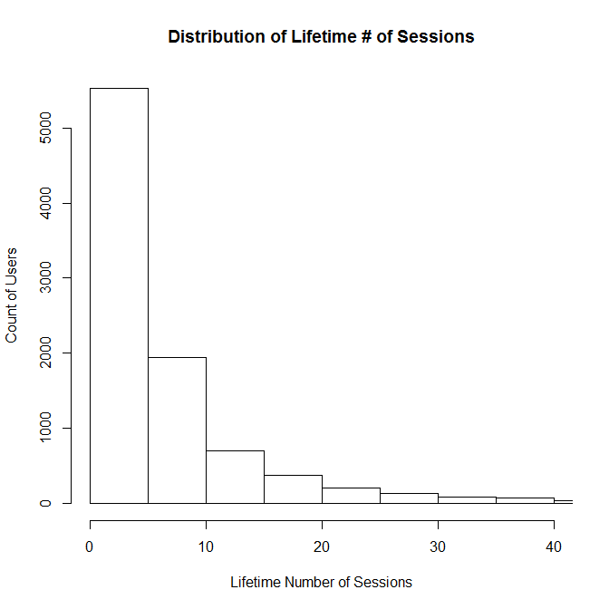
Distribution of Lifetime Sessions
Mean = 7.30 (Median = 4)

Slide 9
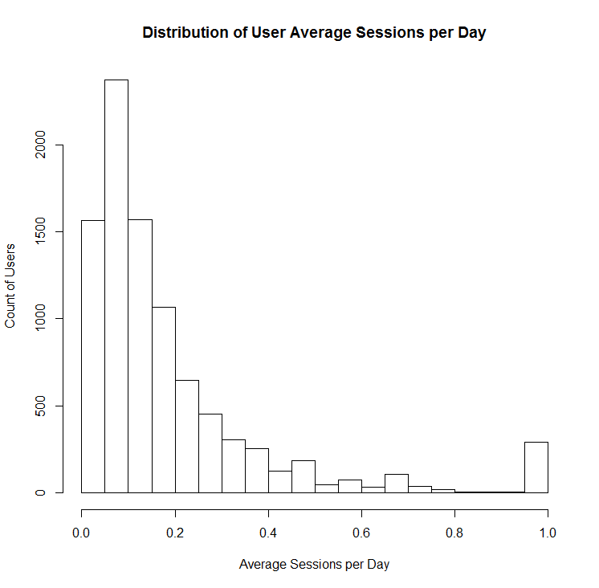
Explore Data
Distribution of Average Sessions per Day
Mean = 0.19 (Median = 0.12)

Slide 10
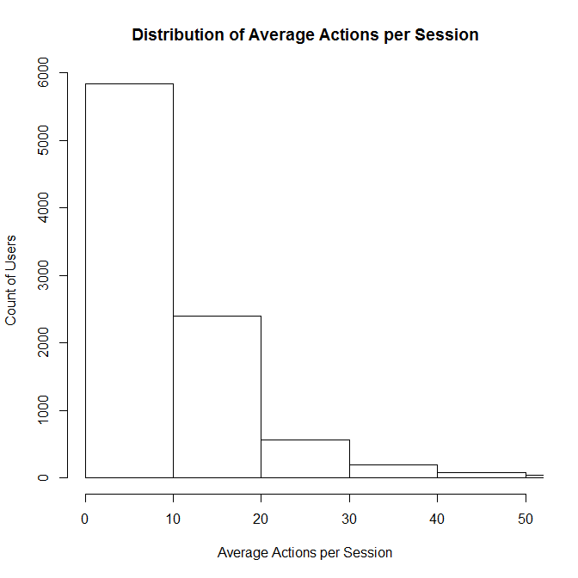
Explore Data
Distribution of Average Actions per Session
Mean = 10.5 (Median = 7.82)

Slide 11
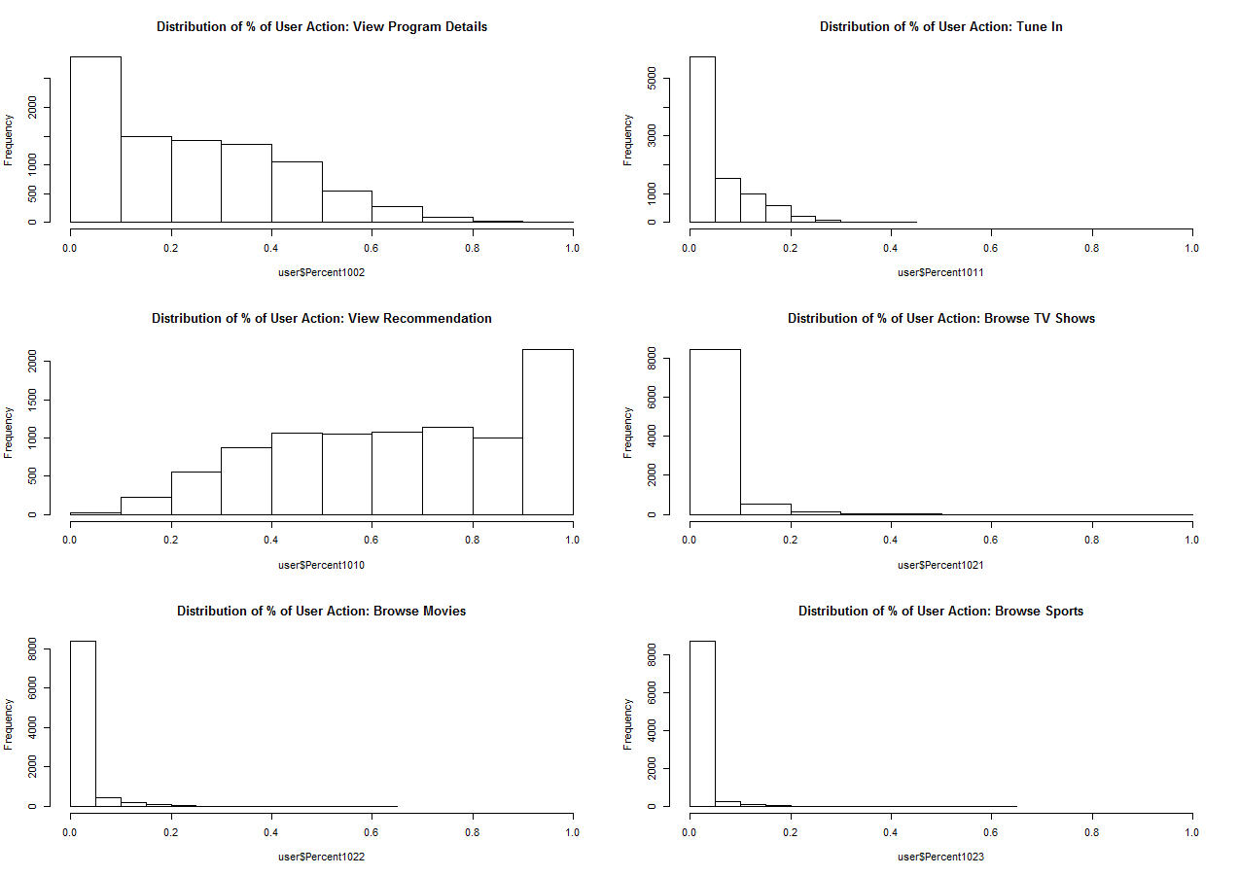
Explore Data
Distribution of %Action “View Program Details”
Distribution of %Action “Tune In”
Distribution of %Action “View Rec’ds”
Distribution of %Action “Browse TV”
Distribution of %Action “Browse Sports”
Distribution of %Action “Browse Movies”
Notes:
9164

Slide 12
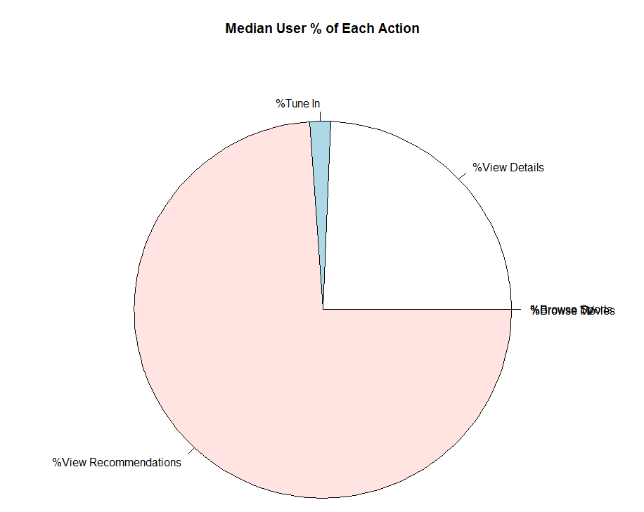
Explore Data
Median User, % of Total Actions

Slide 13
Road Map

Slide 14
Question 1
Find who uses the app for most number of days and see if any actions are a factor in the usage
Descriptive statistics (quantiles, distributions)
Correlation (global regression)
Clustering
Classification (recursive partitioning)

Slide 15
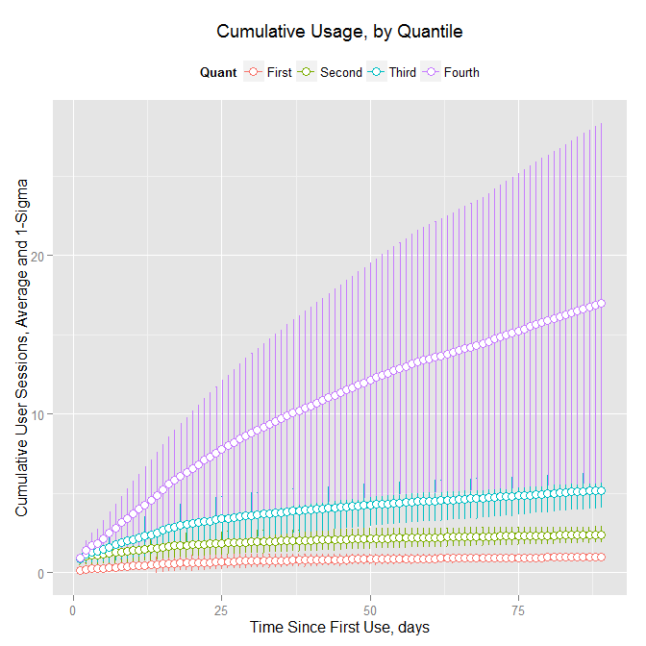
Cumulative Sessions, by Quantile
Mean = 7.3)

Slide 16
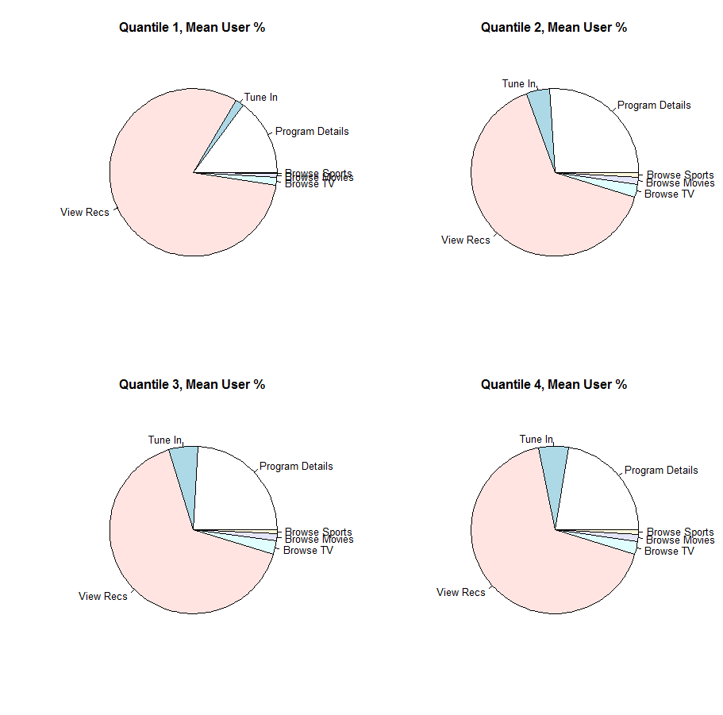
Quantile I, Mean Action %
Quantile II, Mean Action %
Quantile III, Mean Action %
Quantile IV, Mean Action %

Slide 17
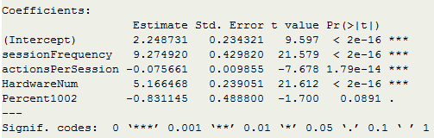
Who Uses it the Most? Regression
sessionFrequency
actionsPerSession
lifetimeSessions
Percent1002/1011/
1010/1021/1022/
1023
Hardware?

Slide 18
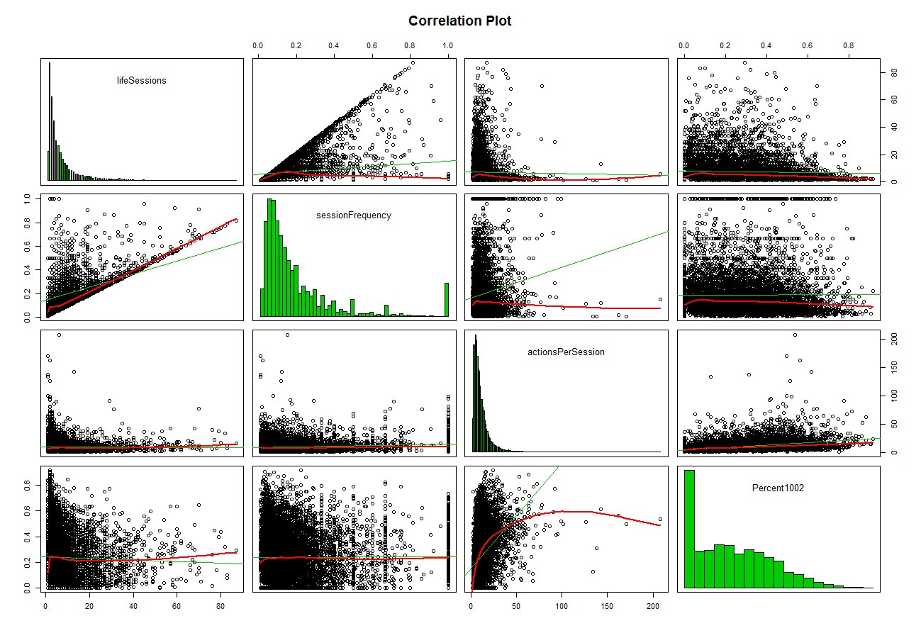
Correlogram

Slide 19
Who Uses it the Most? Clustering
lifetimeSessions
sessionFrequency
actionsPerSession
Percent1002/1011/
1010/1021/1022/
1023
Hardware?

Slide 20
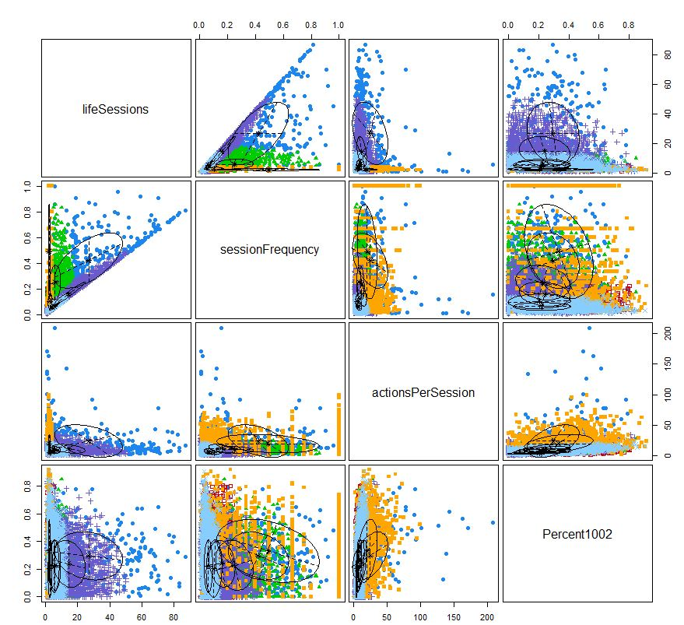
Model Based Clustering
Cluster Matrix
lifeSessions
sessionFrequency
actionsPerSession
percent1002
Notes:
4 clusters, model-based clustering

Slide 21
Who Uses it the Most? Classification
sessionFrequency
actionsPerSession
Quantile of lifetimeSessions
Percent1002/1011/
1010/1021/1022/
1023
Hardware?

Slide 22
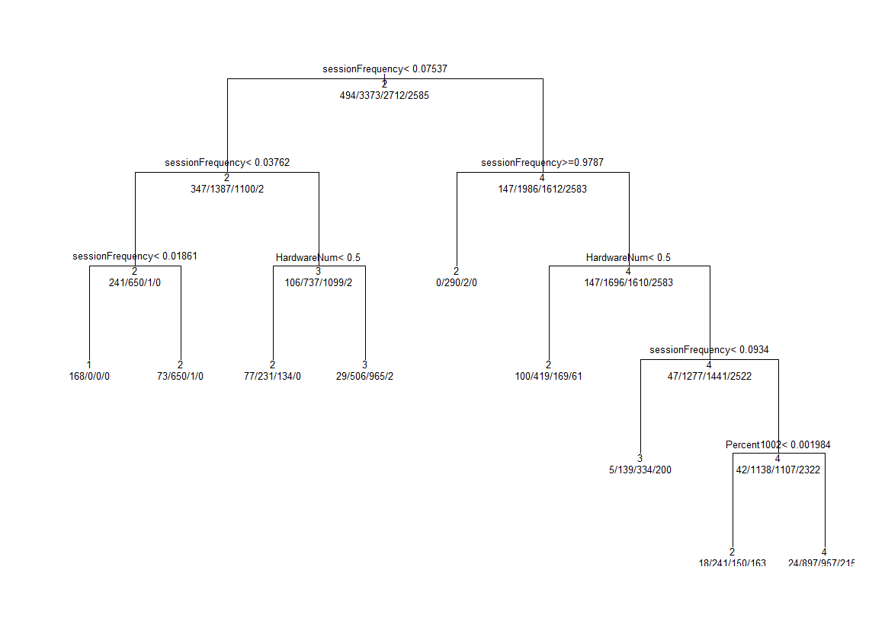
Who Uses it the Most? Classification

Slide 23
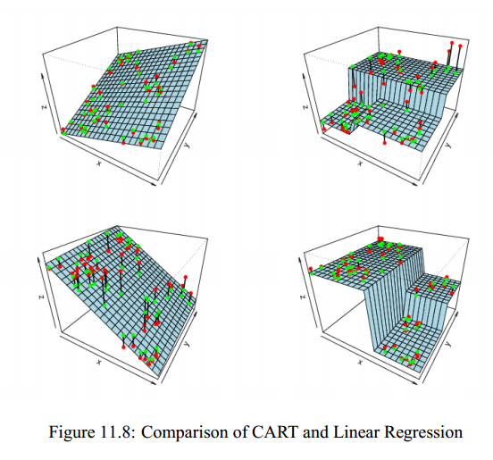
Who Uses it the Most? Classification

Slide 24
Road Map

Slide 25
Question 2
Given the first 2 weeks of usage, predict what will be the number of sessions for the user
Limit training data window to 2 weeks
“Adoption” is they continued using at least 30 days after 2 week window
Train 2 Weeks
Delay
Check for Adoption
30 Days
30 Days
30 Days

Slide 26
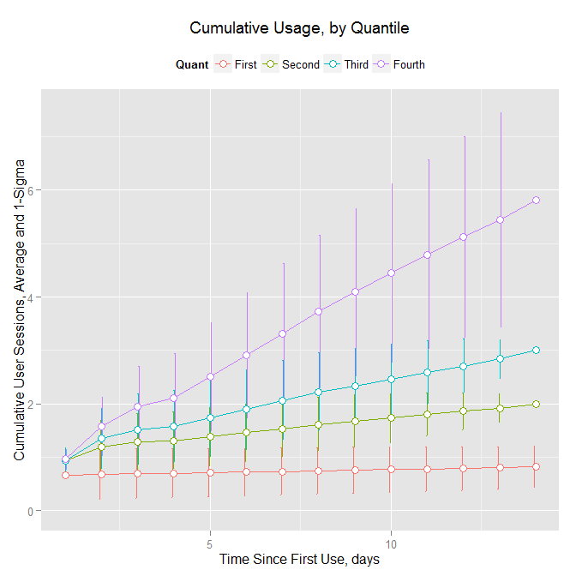
Who Will Use it the Most?
Cumulative Sessions, by Quantile

Slide 27
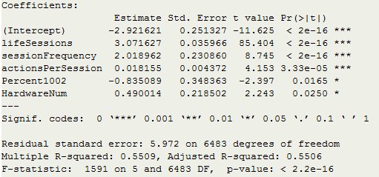
Who Will Use it the Most? Regression
lifesessions
sessionFrequency
reallifeSessions
actionsPerSession
Percent1002
Hardware?

Slide 28
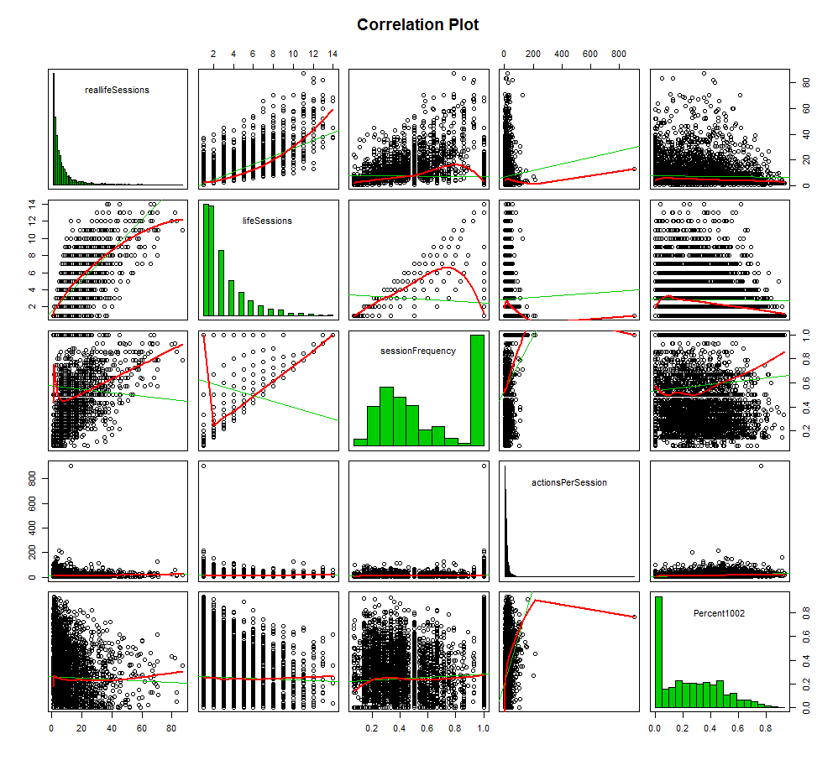
Who Will Use it the Most?

Slide 29
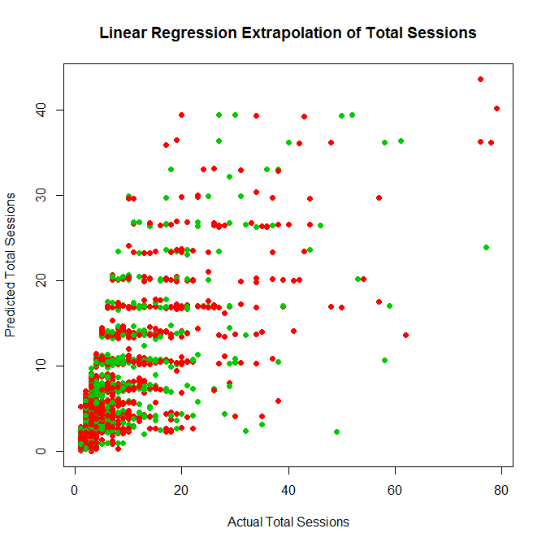
Who Will Use it the Most?
Linear Regression Extrapolation of Total Sessions
Based on 2-Week Observation
R² = 0.507

Slide 30
Who Uses it the Most? Classification
lifeSessions
sessionFrequency
Adoption?
actionsPerSession
Percent1002
Hardware?

Slide 31
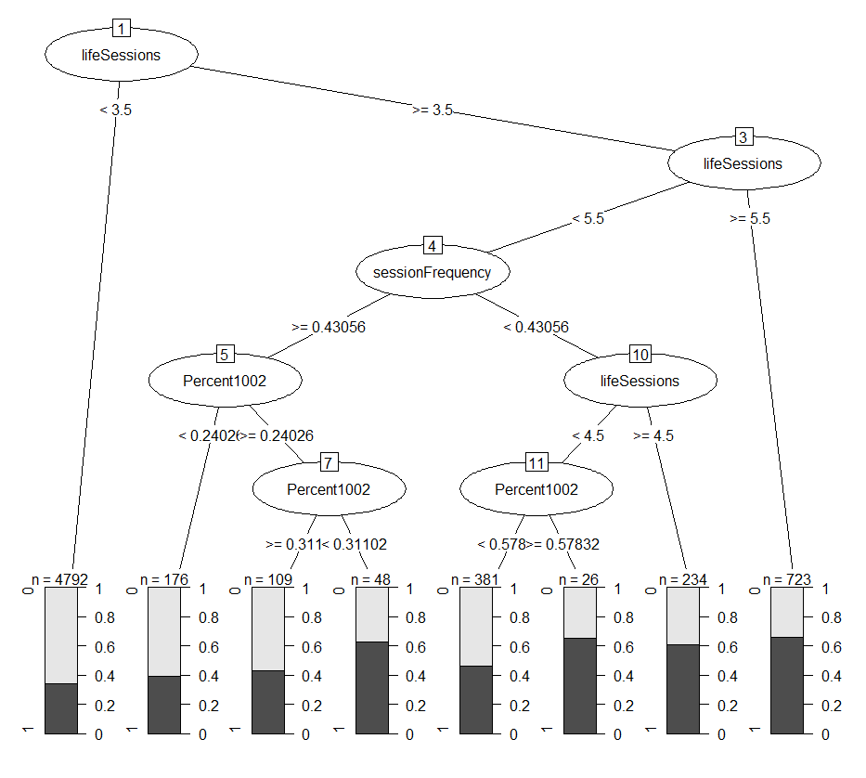
Adoption Classification Model

Slide 32
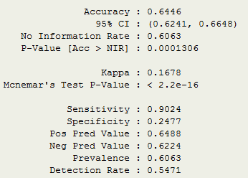

Who Uses it the Most? Classification
Confusion Matrix

Slide 33
Who Uses it the Most? Classification
lifeSessions
sessionFrequency
Quantile
actionsPerSession
Percent1002
Hardware?

Slide 34
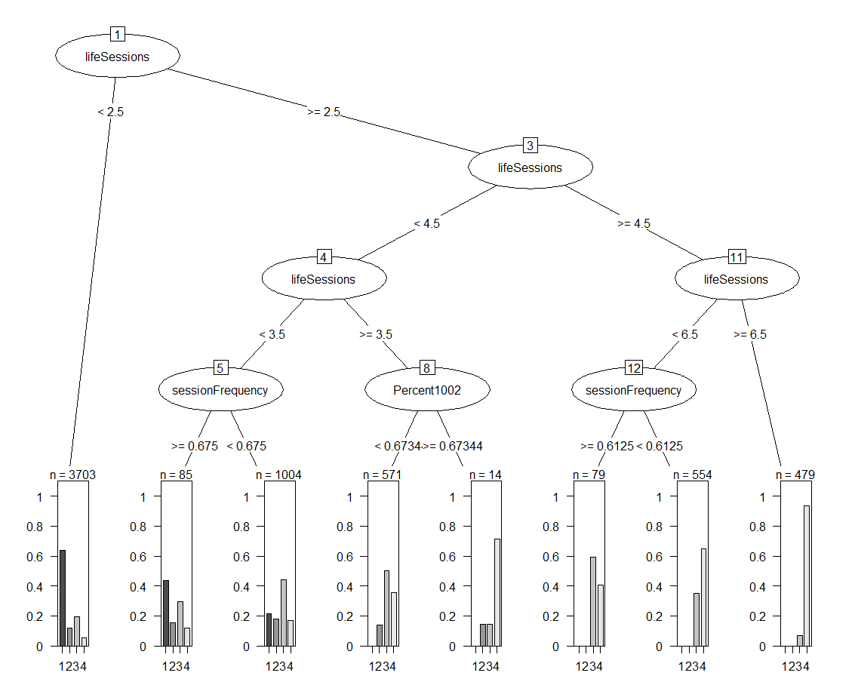
Quantile Classification Model

Slide 35
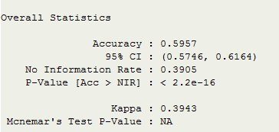
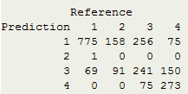
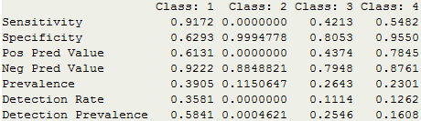
Who Uses it the Most? Classification
Confusion Matrix

Slide 36
Road Map

